Slide 1

Sepsis Cases – Event Log
Maya naor, Asaf Ben or, Noam Diamant

Slide 2
Description of the problem
Sepsis: Body's extreme reaction to infection
Potentially life-threatening condition
Process mining in healthcare:
Reveals patient trajectories in hospitals
Verifies alignment with medical guidelines
Helps improve clinical practices

Slide 3
Sepsis Event Log
1050 patient traces over an 18-month period
15,214 events
16 different activities and 39 data attributes
Case duration:
Median: 5.3 days
Mean: 28.5 days
Notes:
Recorded by hospital ERP system (how to traces recorded)
Examples of activities:
ER Registration, ER Triage, ER Sepsis Triage, Leucocytes, CRP, LacticAcid, IV Liquid, IV Antibiotics
Example of attributes:
Age, Time etc

Slide 4
Trace Example
Traces represent different processes for various patients
A trace is a sequence of actions patient undergoes
It illustrates typical patient journey in this case

Slide 5
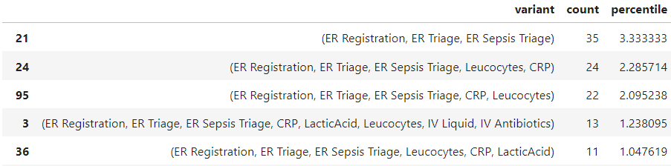
Data Analysis
Analyzed 5 most frequent process variants
Common start: Emergency Room registration
Unexpected finding: No variant ends with discharge
Notes:
Issue requires further investigation Will address this problem later in section

Slide 6
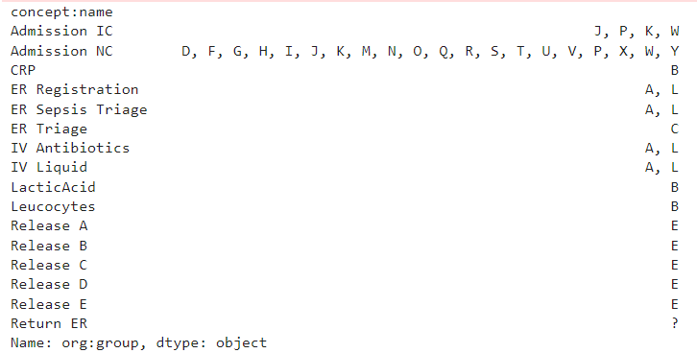
Data Analysis - Continued
Problem solution approach:
Mapped activities to dataset letters
Identified valid end activities
Notes:
More analysis that have been done:
Discovering the most frequent activities
Two most frequent activities: Leucocytes
CRP

Slide 7
Data Cleaning
Data filtering process:
Defined valid start activity: ER Registration
Defined valid end activities (6 types of release/return)
Applied filters to event log:
Kept only traces starting with valid start and end activities
Results:
Number of remaining traces – 734
Number of traces in the original log - 1050

Slide 8
Model Discovery
Model discovery techniques used:
Alpha algorithm
Inductive miner
Model discovery process:
Used varying numbers of most common traces
Compared results across different trace counts
Notes:
Compared results across different trace counts

Slide 9
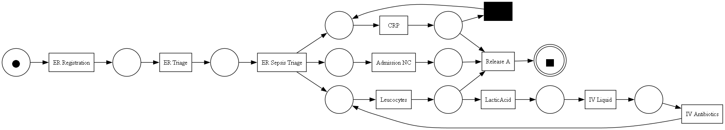
Model Discovery - Results
Most common trace only:
3 most common traces:
Notes:
Compared results across different trace counts

Slide 10
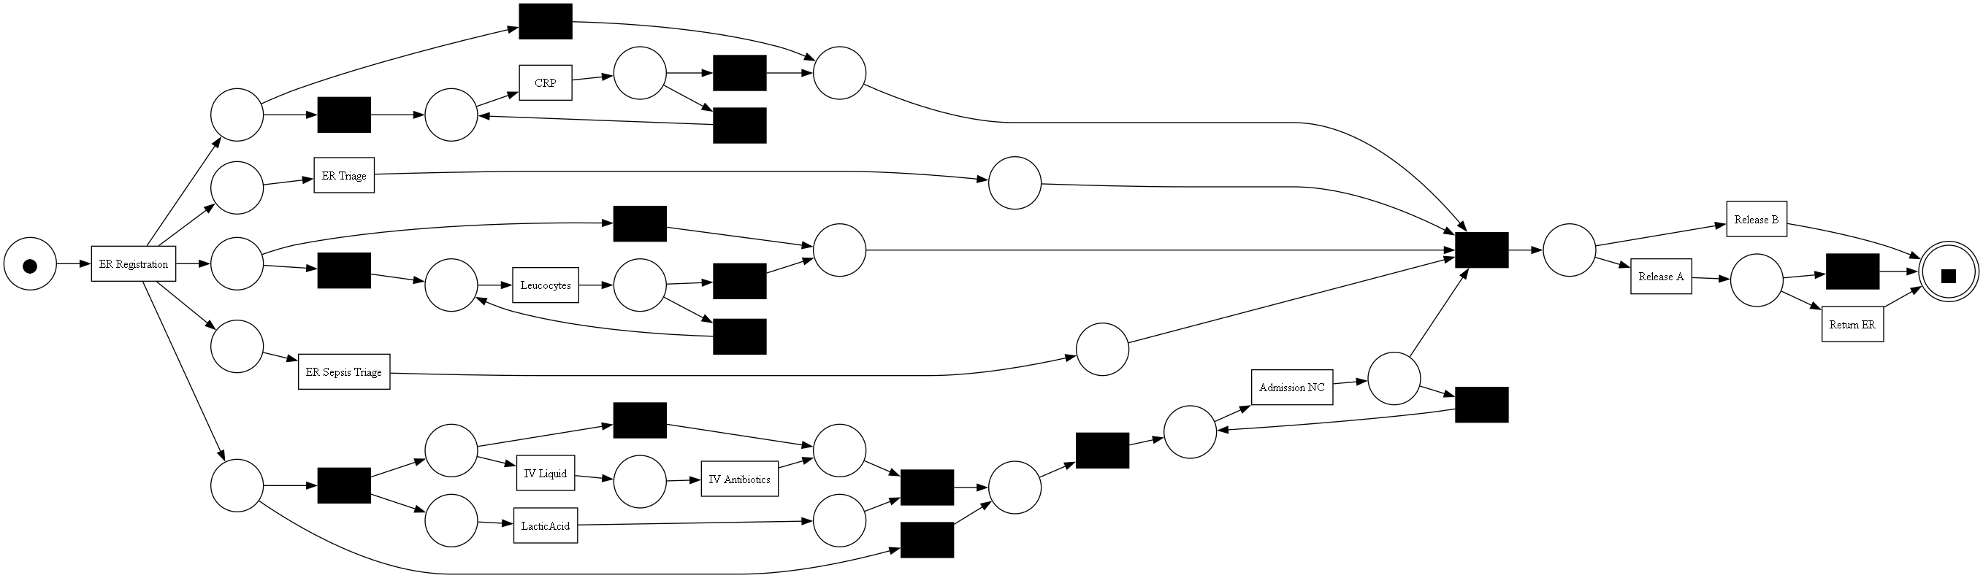
Model Discovery – Results Con
35 Most Common Traces:
Notes:
Compared results across different trace counts

Slide 11
Conformance Checking
Evaluated four quality metrics for each model:
Fitness, Precision, Generalization, Simplicity
Compared results across different trace counts
Notes:
Compared results across different trace counts

Slide 12
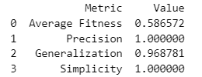
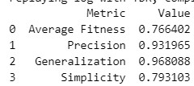
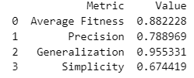
Conformance Checking - Results
1 most common traces:
3 most common traces:
5 most common traces:
Notes:
Compared results across different trace counts

Slide 13
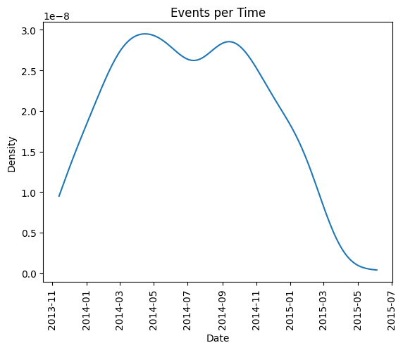
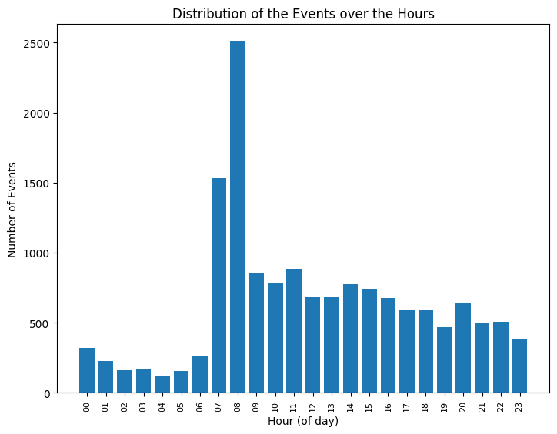
Distribution of events over time
Hourly and date analysis
Time is important attribute
Notes:
Compared results across different trace counts

Slide 14
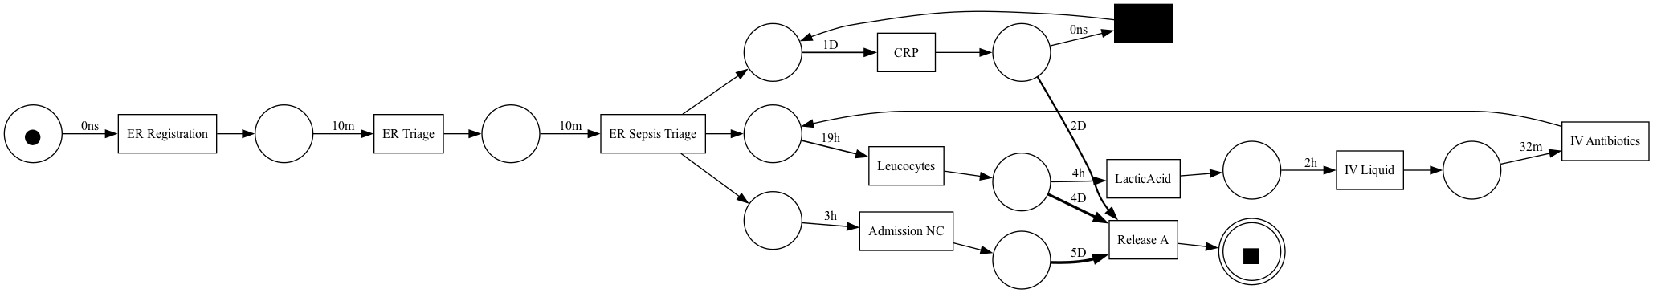
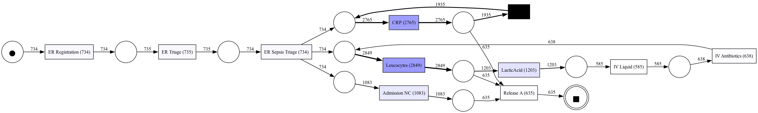
Further analysis – time and frequency
Temporal Information
Frequency Information
Notes:
Compared results across different trace counts

Slide 15
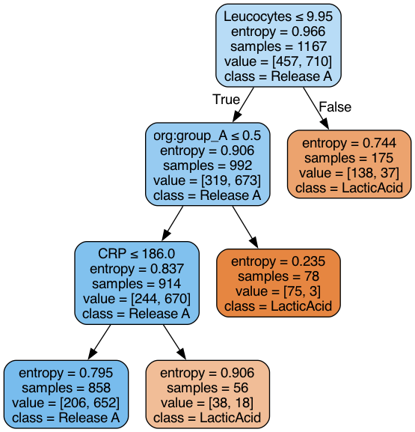
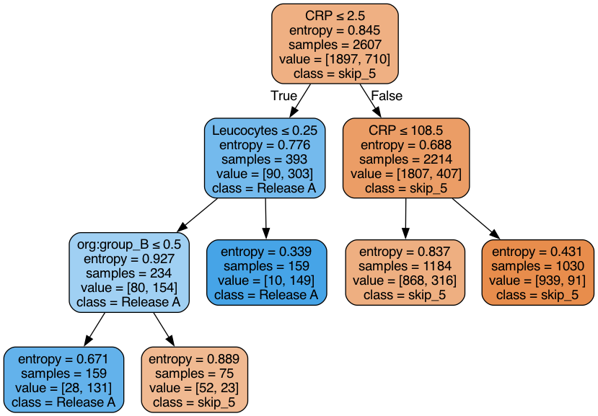
Mining Decision Points
Two decision points:
After CRP
After Leucocytes
Impure leaves observed, Possible implications:
Complex decision
Notes:
Compared results across different trace counts

